Slide 1
JavaScript Events
CS 261
Presented by Amy Cook

Slide 2
JavaScript Events are “things” that happen to HTML elements
Events are a way to interact with the user on the page
Events listen for something specific to happen and react in some way.
HTML elements
<div onfocus=“changeColor( )”>
<p onmouseover=“highlight( )”>
<button onclick=“getInfo( )”>
<input onsubmit=“return validate( )”>
<body onload=“hideElement( )”>
<video onended=“endMessage( )”>

Slide 3
Event Types
Project guidelines: “I expect events from at least three different families of event.”
https://www.w3schools.com/jsref/dom_obj_event.asp
See “Belongs To” column
Click on an event type to go to a page with all events of that type
Click on an event name to go to a page with examples of that event
Some simple ones to try:
MouseEvent
KeyboardEvent
UiEvent
FocusEvent
** TouchEvents are for
touch screens only!

Slide 4
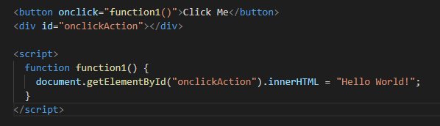
MouseEvent
onclick - 1
Executes JavaScript when the left mouse button is clicked
-- onmouseup and onmousedown =
Left, middle, or right mouse buttons

Slide 5
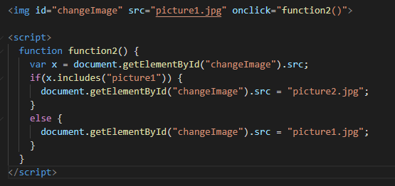
MouseEvent
onclick - 2
Executes JavaScript when the left mouse button is clicked
onmouseup – left and middle mouse buttons are clicked
onmousedown – left, middle, and right mouse buttons are clicked

Slide 6
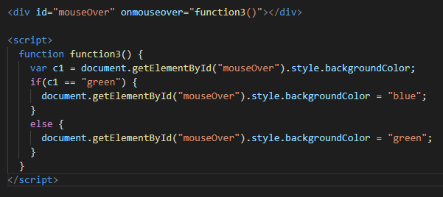
MouseEvent
onmouseover
Executes JavaScript when the cursor is placed over an element

Slide 7
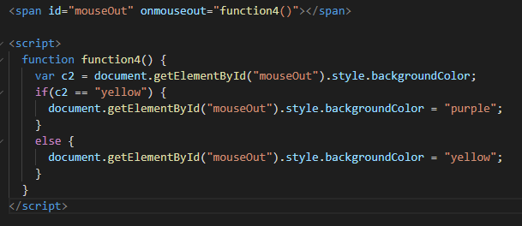
MouseEvent
onmouseout
Executes JavaScript when the cursor is sent away from an element

Slide 8
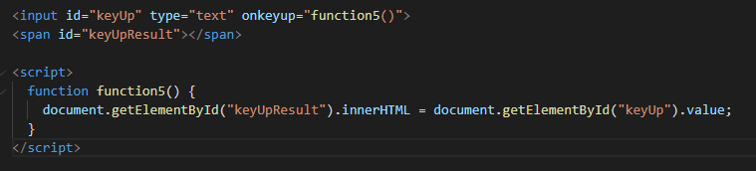
KeyboardEvent
onkeyup
Executes JavaScript when the user presses a key
onkeydown – event occurs when user is pressing a key
onkeypress – event occurs when user presses a key
onkeyup – event occurs when the user releases a key

Slide 9
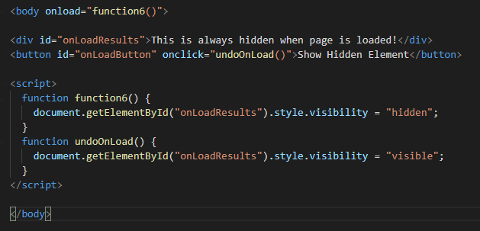
UiEvent / Event
onload - 1
Executes JavaScript when an element has loaded

Slide 10
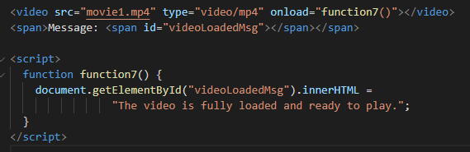
UiEvent / Event
onload - 2
Executes JavaScript when an element has loaded

Slide 11
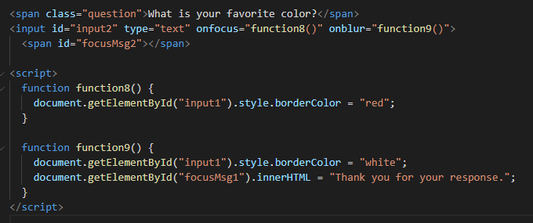
FocusEvent
onfocus
Executes JavaScript when an element gets focus
onblur
Executes JavaScript when an element loses focus

Slide 12
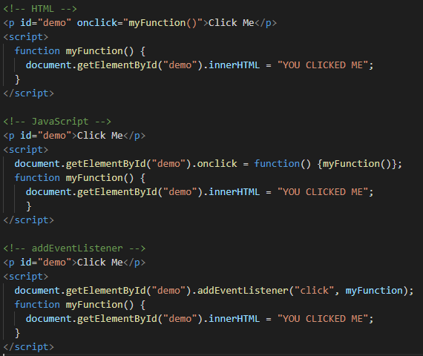
3 Ways
Click Me
YOU CLICKED ME

